Slide 1

Enhanced Remote Face Anti-Spoofing
KONERU LAKSHMAIAH EDUCATIONAL FOUNDATION
Department of Computer Science & Applications
Guided By :
Mrs. Avula Chitty, (PhD)
Assistant Professor
Presented By :
N. Bhanu Teja
Regd No : 2301600099
Course : MCA (Cyber Security)

Slide 2
Contents
Introduction
Objective
Scope of the Project
Literature Survey
Problem Identification
Proposed Work
Architecture Design And UML Modeling
Technical Design
Results
Conclusion
Reference

Slide 3
Abstract
Ensuring the security of digital identities is essential, and face authentication systems have emerged as a robust solution against various attack vectors. This project implements an advanced face authentication system, integrating multiple layers of protection to detect and mitigate spoofing attempts.
The authentication process consists of two methods: credential verification and face verification. To ensure the liveness of the subject, real-time detection methods such as blink detection and head movement analysis are applied.
Furthermore, the project introduces an email alert system to notify users of successful and failed login attempts, contributing to greater transparency and security. The comprehensive design ensures resilience against presentation attacks, deepfake-based intrusions, and adversarial manipulations, making it a reliable face authentication solution.

Slide 4
Introduction
Face anti-spoofing is crucial for protecting digital identities
Conventional methods detect presentation attacks but fail against advanced digital injection attacks (Deepfake, replay attacks, adversarial noise).
This project analyzes vulnerabilities in state-of-the-art face anti-spoofing systems and proposes a robust solution

Slide 5
objective
The main objective of enhanced remote anti-spoofing is to identify and mitigate vulnerabilities in face anti-spoofing models.
Develop a robust system against digital injection attacks
Enhance generalization using domain adaption techniques

Slide 6
Scope of the project
This project aims to enhance security in face authentication systems by addressing vulnerabilities in spoof detection
It is applicable in various domains such as banking, secure access control, and online identity verification
The system can be extended to real-time facial authentication for mobile and IoT devices
The proposed solution will be tested against various spoofing techniques to ensure high accuracy and reliability.

Slide 7
Further Proceedings
Data Collection : Gathering user image data with web camera.
Data Processing : Normalizing images, augmenting data for better generalization.

Slide 8
Problem Identification
Security Threats : Spoofing attacks threaten face authentication security
Existing Weakness : Traditional methods fail against digital injection attacks.
Need for Improvement : Advanced anti-spoofing techniques are necessary to combat evolving threats

Slide 9
Proposed work
Advanced Anti-Spoofing Techniques : Frequency-domain texture analysis and real-time prompts.
Proactive Defense Mechanisms : Challenge-response techniques like screen flashing & movement detection.

Slide 10
Drawbacks of the Existing System
Vulnerability to Digital Attacks : Fails against Deepfake and replay attacks
Limited Generalization : Poor cross-domain performance
Passive Model Design : Single-frame models lack robustness against unseen attacks

Slide 11
Architecture design and uml modeling

Slide 12
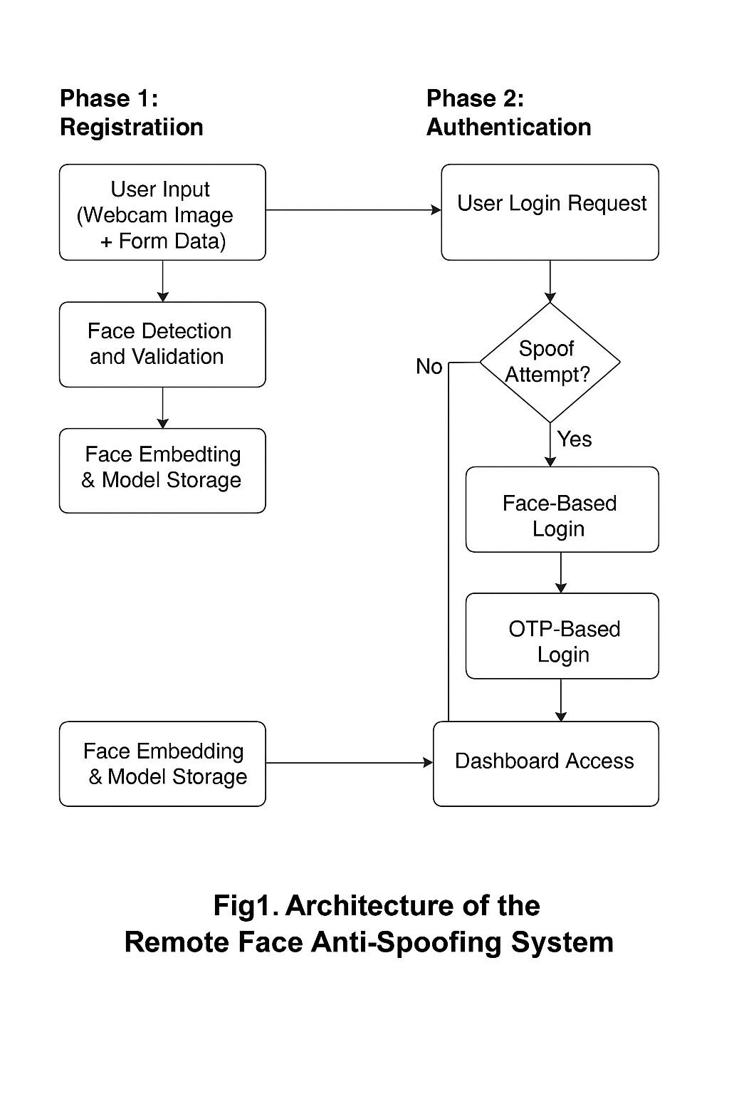
System architecture

Slide 13

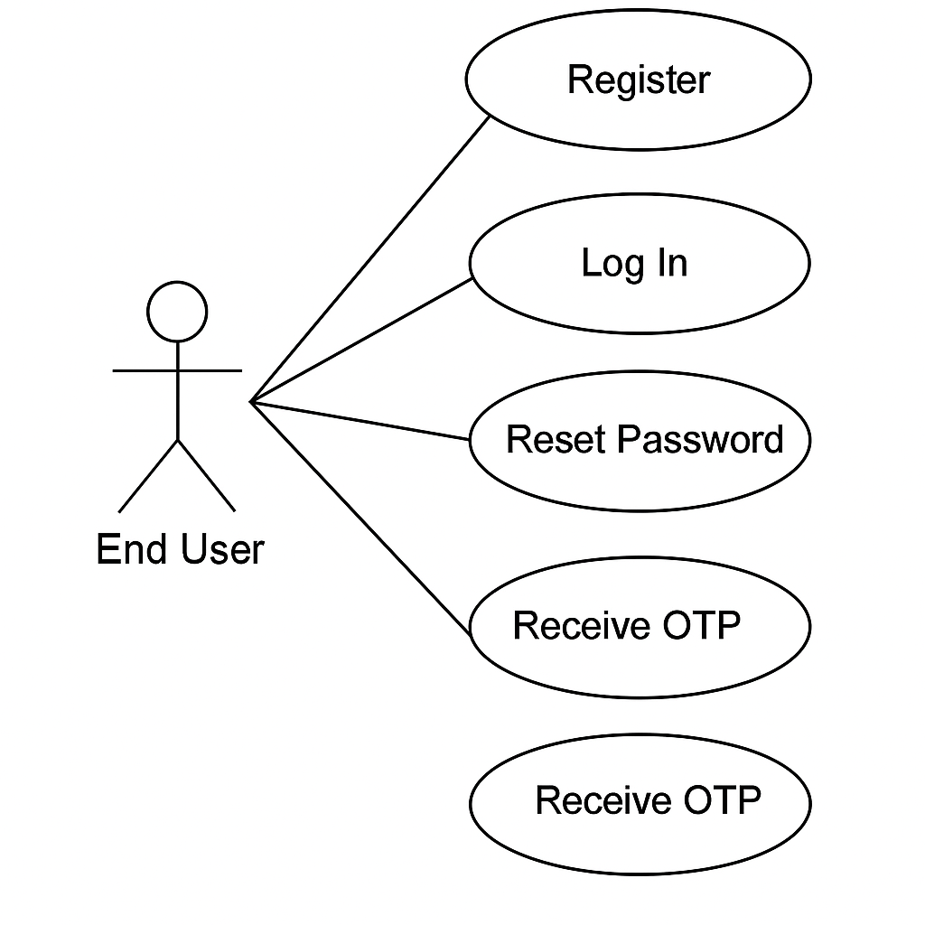
UML Modeling
Use Case Diagram :

Slide 14
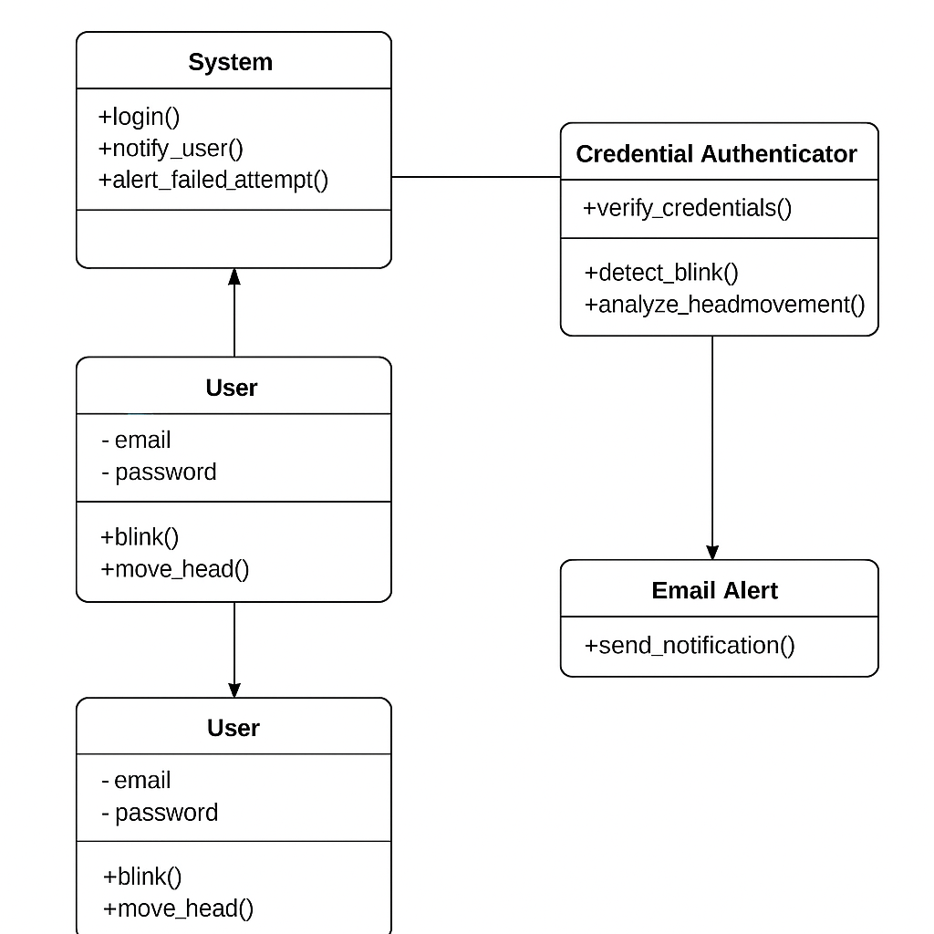
Class Diagram :

Slide 15
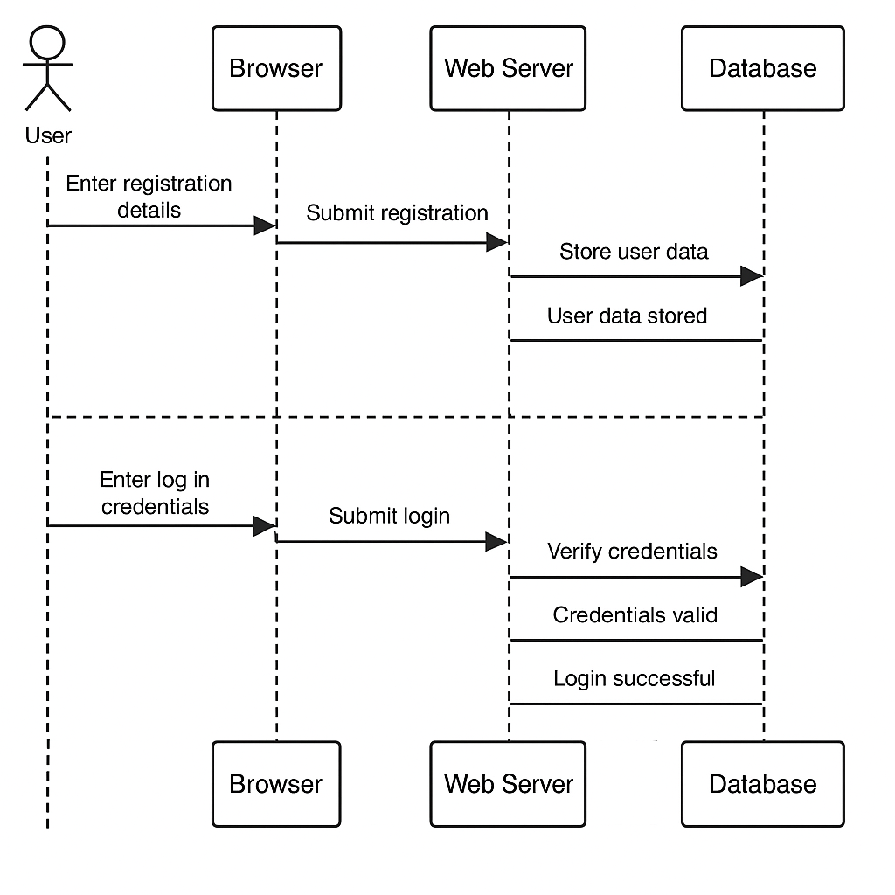
Sequence Diagram :

Slide 16
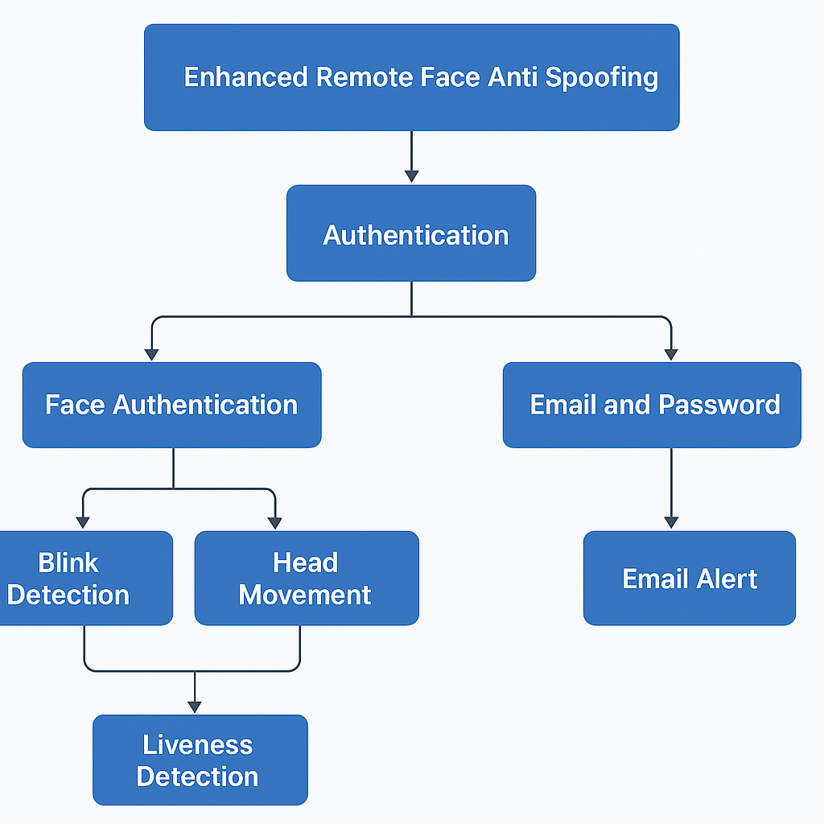
Collaboration Diagram :

Slide 17
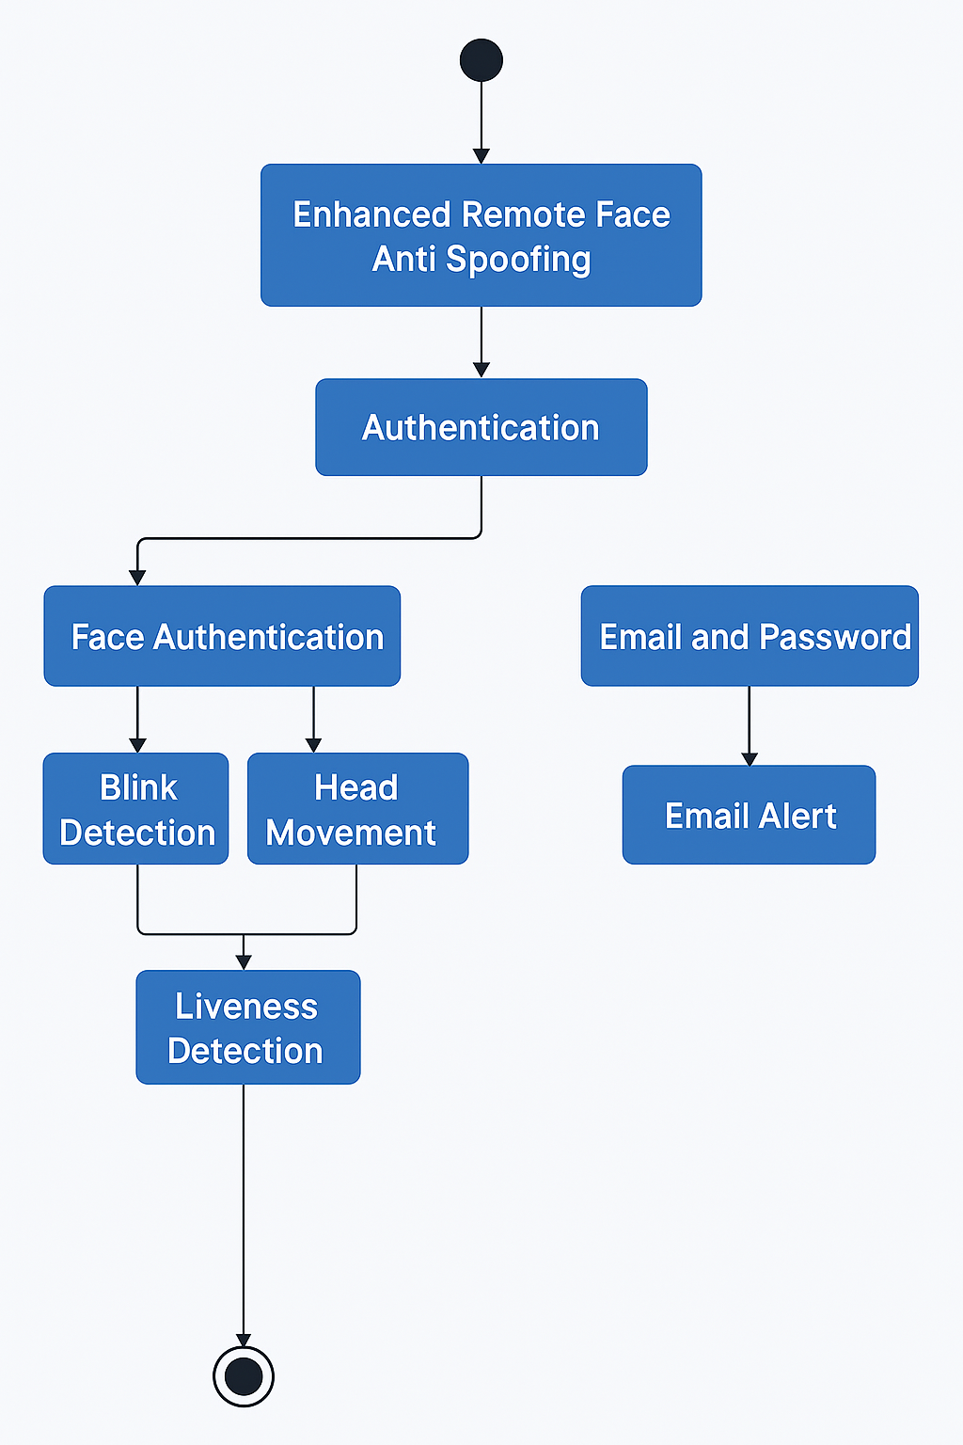
State Chart Diagram :

Slide 18
Code Link
Link https://github.com/Teja-1811/Final.git

Slide 19
Conclusion :
The project successfully developed a robust face anti-spoofing system
Implemented state-of-the-art machine learning techniques for improved accuracy.
Address vulnerabilities in face authentication systems, enhancing security

Slide 20
References :
“Principles of Designing Robust Remote Face Anti-Spoofing Systems” (June 2034)
Various research papers on CNN-RNN models for face recognition

Slide 21
Thank you

Slide 22
Authentication Methods Comparison
1. Face Authentication:
- Uses webcam to capture user's face in real-time.
- Performs liveness detection (blink, head movement).
- Matches face embedding with stored profile.
2. Email and Password Login (with OTP):
- User enters credentials.
- OTP sent to registered email for verification.
- Login success only after OTP confirmation.

Slide 23
Results and Performance Metrics
• Face Recognition Accuracy: 96.4%
• Precision: 97.1%
• Recall: 95.3%
• F1-Score: 96.2%
• False Acceptance Rate (FAR): 2.1%
• False Rejection Rate (FRR): 3.2%

Slide 24
Live Demonstration
• This slide serves as a transition to the live demo.
• Show webcam face login or email+OTP flow.
• Optional: demo email alert on login attempt.

